Slide 1
Increasing the Visibility of Young Fathers
Culture Change and Listening to Young Fathers
Dr Mark Osborn
markosborn@ntlworld.com

Slide 2
Culture
Ages of concern: learning lessons from serious case reviews Ofsted2011
“The father is just as important as the mother.”

Slide 3
Systemic change
Providing support systems for young fathers to be effective role models for their children
Developing activities that support “team parenting”
Helping parenting partners to communicate to reduce relationship crisis

Slide 4
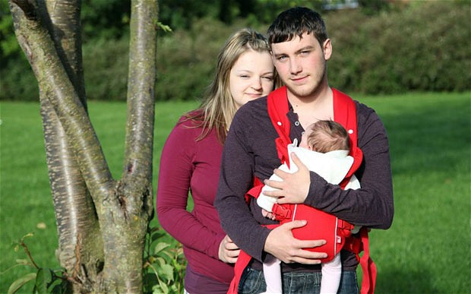
FATHERS who take part in parenting support develop:
greater knowledge & understanding of child development
more involvement and higher-quality interactions with child
greater parental competence
improved communication skills
greater sensitivity to babies’ (and partners’) cues
increased parental confidence and satisfaction
positive changes in view of self
increased acceptance of child

Slide 5
Fathers are biologically ‘wired’ to take care of babies
Fathers, like mothers, secrete hormones that help them bond with their babies: the more care they do, the more hormones they secrete.
AND once men’s bodies have been ‘primed’ physiologically to care for babies, they become more quickly ‘flooded’ with hormones on holding a baby
(for review, see Gray & Anderson, 2010)
Notes:
Vasopressin: higher in fathers of young children (facilitates response to infant cries, carrying/holding, promotes social memory)
Prolactin (the “breastfeeding hormone”): highest among experienced fathers and promotes closeness and care (reciprocal effect)
Oxytocin (the “love hormone”): elevated levels in sustained pair bonding and infant care (promotes/reflects strong social connections)

Slide 6
Recent survey with young fathers
“Just people not seeing you as a dad and being treated differently, and the mum she gets everything and I am left to fend on my own.”
“Because we are the dads it’s not seen as important and that makes us feel like we are not valued. So if I walked away from my daughter then who would care, apart from me.”
“I went into a Children’s Centre recently and was asked if I was lost”

Slide 7
“From my experience when I tell workers I am going to be a father I feel I am talking to a brick wall.”
“When everyone don’t understand how hard you try or how much you want to be there.”
“It’s changed my life. I’ll do anything for my son. I’m responsible.”
“If I had a professional to encourage me more and tell me that I can be a good father.”

Slide 8
The P word
Parent = mother

Slide 9
The P words
Policy
Procedure
Paperwork
Practice
Performance management

Slide 10
Steps to take
Collect data
Create information
Develop knowledge

Slide 11
markosborn@ntlworld.com

