Slide 1
Seeing Young Fathers in a Different Way
Bren Neale and Carmen Lau Clayton
The Following Young Fathers Study: Final Conference
University of Leeds 30th September 2015

Slide 2
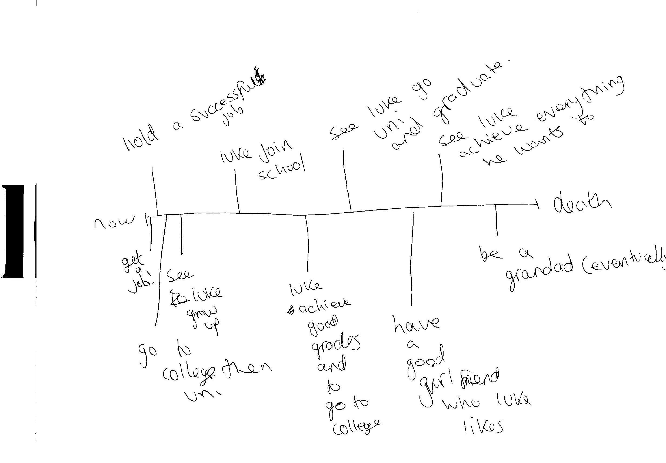
Future Timeline:

Slide 3
Feckless Young Fathers?
“I think it’s absolutely outrageous that so many young men in our society feel they can go out, get women pregnant, allow them to have children, make them bring them up by themselves, often on benefits, and then just disappear. It is utterly shocking and I hope … the ministers will get hold of some of these feckless fathers, drag them off, make them work, put them in chains if necessary …”
(David Davies, MP 12.11 2013, House of Commons,
(BBC.co.uk/news/UK-Wales-politics)

Slide 4
Strength of the ‘Feckless’ Discourse
Because you’re young parents … you don’t tend to get the respect. I mean, I remember a nurse coming in and saying to us, ‘oh, have you got a social worker coming in or something?’ I turned round to her. I just said, ‘I don’t know why they’d be coming to seem me! … I’m not some scumbag that’s just having kids willy nilly, here there and everywhere’ (Tommy, aged 22, ante-natal care).

Slide 5
Transitions into Early Fatherhood
I wouldn’t change Sylvie [daughter] for the world, but maybe I wish I would have waited until I had a job … and a little bit more money. … You need a job just to pay your bills. But things happen don’t they? (Andrew, age 16)
I’ve been to the scans and antenatal classes, all the doctors appointment that she’s had. ... I didn’t want her to feel like just cos we’re single, like, I can’t come and help her (Orlando, age 24)
I can’t give him the best possible life. But it’s quite crazy. Once he were born and I seen him, like, it changes everything. … Nothing else matters. Everything you do is for him. … It’s impossible to describe, I think. It’s just overwhelming (Jason, age 21)

Slide 6
Lived Experiences of Parenting
I want to be the person who [my son] can turn to. And who, obviously, who is always gonna be there for him. ... You know, when I’ve got him, and when he does something, when’s he’s growing up, you know, it’s the happiest emotion cause you just wanna give him a kiss and a cuddle. He’s my little man. ... He’s so - you feel really proud, really, really proud (Dominic, age 18).

Slide 7
Relationships with the Mother of the Child
You build a really good respect for each other. . . Before you were just girlfriend and boyfriend, kind of separate, but now you’re conjoined, you’re going for a common goal (Zane, age 18)
We are separated and we do get along , we do what we need to do (Orlando, age 24)
She tries to use [daughter] as a weapon, playing games and stuff (Karl, age 16)

Slide 8
Grandparental Support
Her mum didn’t want her to [have an abortion]. My ex girlfriend probably thought, ‘my mum knows best’. You’re going to listen to your mum, aren’t you? (Callum, age 19).
I’m going into someone else’s territory and I didn’t feel like I could be myself around my kids (Iman, age 16).
Her mum won’t let me go up to her house no more and, like, I want to see [my son] (Jimmy, age 16).
She’ll just do everything that a parent does basically, but she’s grandma (Adam, age 16). … It’s hard, just the two of us (Adam, age 17).

Slide 9
A Place to Parent?
I’d sooner stay at my mum’s - it’s a nice environment so he can grow up without getting hurt (Jed, age 16).
I’m like sponging off people’s mums and that. And then obviously I can’t go and see [partner], she can’t bring [my son] down to see me (Jimmy, age 16).
I got kicked out of my mum’s for not being able to pay to live there. So then I was homeless for about two or three months. I was living at my mates, at my dad’s, just in and out of houses (Adam, age 16).
[My son] can’t come [to the hostel] … And I’ve got to be there … four nights a week. I can go out but if I haven’t got money to get to my places, I’ve gotta walk it (Adam, age 18).

Slide 10
Becoming a Breadwinner?
I could just get a job now - stop my studying and just, you know, any money I give it to the kids. But then what is that benefiting the kids? That’s just money for now. It’s not putting nothing in place for them (Iman, age 16).
[I’m on] benefits money - you haven’t earned it, so I haven’t provided. … getting up in t’ morning and grafting all day and then coming home … that’s providing. I’d much rather be in a job (Jax, age 19).
They always lay me off. I’m always looking again and looking again, until I find something again and I just start right over again (Marcel, age 24).

Slide 11
Custody: Risk or Redemption?
It were horrible not seeing my son … knowing I were missing the most important part of his life. I just felt I’d let him down big time. … When I got out we didn’t have a bond. … That’s the price I paid for being an idiot (Jason, age 21).
If it wasn’t for prison I wouldn’t be a father. I would not be the dad I am today. … If you’ve got your children out there, but you’re in and out of prison, how does that work? It can’t work! The first fatherhood group, it was amazing. It literally taught me a lot of things. …. Me being a father should be a privilege (Raymond, age 20).

Slide 12
Redemption Ethos
When [there is] a pregnancy … they care a lot about it. There are some young men … who are dangerous … but they are a real minority. … Young fathers get excluded, especially if they’re considered risky. … It needs to be seen that they’re just as important as mothers. Someone needs to try and understand them and work with them. Yes, they might end up being too risky, but then it’s actually safer to identify who they are and work out what the issues are than just ignore them (Staff Nurse, Secure Training Centre).

Slide 13
Are Young Fathers ‘Hard to Reach’?
Surveillance: I don’t like it …when someone’s watching you. … You feel stupid ’cause you’ve got people looking down on you. … You [want to] feel more confident. You … don’t [want to] feel like a bloody criminal (Callum, age 19, Contact Centre).
Side-Lining: [It was like] I weren’t there. They didn’t speak to me (Jimmy, age 16, Midwives).
[It’s] benign neglect. But it also tips into exclusion and rudeness (Local Authority, Head of Commissioning).

Slide 14
Or Services ‘Hard to Access’?
I haven’t got no-one really to speak to in terms of, like, talking about what’s happening with [my] son and all. So … I’m on my own now pretty much. … I’d like someone to speak to. … Someone to listen and give me advice, but … I wouldn’t know where to start (Jimmy, CAFCASS, CJS)
You can just tell him owt and talk to him properly. He’s totally down to earth. … I did a fathers group that he ran… [then] I was doing peer mentoring… like you’d help other teenage fathers and stuff. … It felt like I’m needed to do summat, like I’m wanted. … I don’t know where I’d be now if it weren’t for him. … He makes you think about things … in the right way. And makes you see sense. And that’s helped me a lot in life ‘cause I’ve been in a lot of dark places (Callum, Local Authority Learning Mentor Scheme)

Slide 15
Summary
Despite countless obstacles and difficulties, young fathers were committed to their children and striving to ‘make a go’ of parenthood.
A policy and practice framework that more proactively acknowledges, supports and encourages young fathers-to-be/ young fathers would be beneficial to young fathers, their children and wider families.
Notes:
A policy and practice framework that more proactively acknowledges, supports and encourages young fathers-to-be/ established young fathers, regardless of their age, relationship status, EET status and family support available would be beneficial to young fathers, their children and wider families

Slide 16
Briefing Papers
1) Becoming a young father: Transitions into parenthood
2) Young Fatherhood: Shared parenting with the mother of the child
3) Grandparent support: The views of young fathers
4) Young breadwinner fathers? Journeys through education, employment and training
5) Young Offender Fathers: risk, resource, redemption
6) Hard to Reach? Re-thinking support for young fathers
7) Finding a Place to Parent?

Slide 17
Training Resources
Book 1: Becoming a young father
Book 2: Being a young father
Book 3: Reflections on young fatherhood

